Slide 1
TCS company
-Yashwanthini Aishwariya

Slide 2

Task -1 Introduction
Tata Consultancy Services (TCS) is a leading global IT services, consulting, and business solutions company.
Headquartered in Mumbai, India, TCS offers a wide range of services and solutions, including application development, maintenance, infrastructure services, business process outsourcing, and consulting.
Known for its strong focus on innovation and customer satisfaction, TCS serves clients across various industries, including banking, financial services, insurance, healthcare, retail, and manufacturing
Day 1: Project understanding, company selection, and product descriptions.

Slide 3
Task -2 Product and service description
Consultancy: offers strategic consulting services to help clients transform their businesses and achieve their goals.
Cloud: offers a comprehensive range of cloud services, including cloud migration, cloud infrastructure management, and cloud application development.
Cognitive business operation: TCS's cognitive business operation services leverage AI and automation to optimize business processes, improve decision-making, and enhance customer experiences.
Cybersecurity: TCS offers comprehensive cybersecurity services to protect clients' digital assets.
ERP: TCS offers comprehensive ERP services to help clients optimize their business processes and improve efficiency.

Slide 4
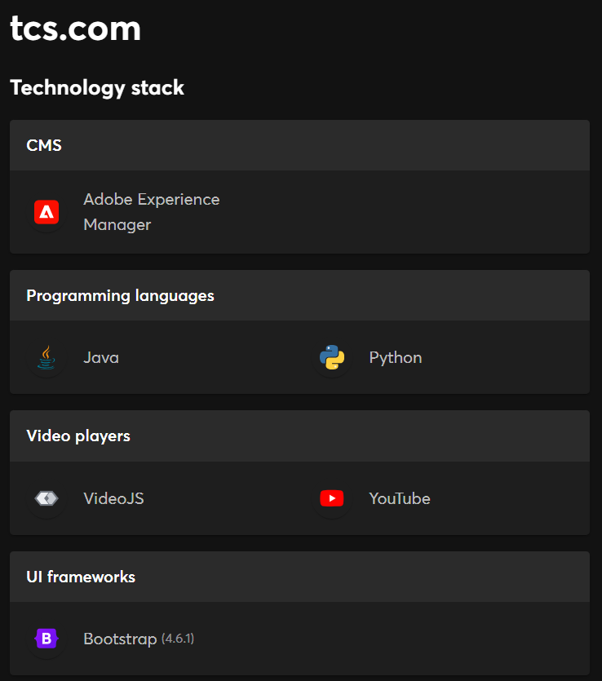
Task – 3 Website platform Identification
The website is made on CMS platform
Day 2: Website platform identification

Slide 5
Task -4 Responsive design testing
Home page
Mobile friendly but font issues exists.
Insights page
Layout is good and font is readable but slow loading exists.
Careers page
Responsive but overlayer issue exists
Service page
Responsive with different font size
About us
Layouts and response is good but readability issues exists
Contact us
Good in responsiveness, layout, font size but interaction can be better
Day 3: responsive design testing.

Slide 6
Task -5 Website Mistakes identification
Suggestions
Optimized images can reduce slow loading
Usage a consistent font family and size throughout the website.
Overcome layer issues by ensuring that website's content is accessible to search engines.
Usage of proper line space and fonts makes readability
Interaction can made to pay the attention of the user
Day 4: Identify website design mistakes and compile best practices list.

Slide 7
Task - 6 Website Best practices list
Usage of clean layout with clear font and text sizes
Optimized images helps in fast loading speed
Clearly defined CTA helps the users to experience more about the website
Fresh and updated content must be followed
The website design must be responsive and mobile friendly to provide the experience for users on all devices

Slide 8
Task -7 landing page design
https://tcs-47780822.hubspotpagebuilder.com/-temporary-slug-b6eea64d-aad9-4318-8bcc-1b23afe492d5?hs_preview=SdQmAaCF-181456740907
Objective : lead generation
Design features
Fast loading speed with mobile friendly
Readable fonts with appropriate size and layouts
Optimized pictured are used
Proper call to action is used with proper visibility
Content is optimized.
Day 5, 6, 7: Landing page design and creation

Slide 9
Conclusion
Since this is a hands on projects, experienced many granularities about the digital marketing field with respect to the task
It also gave an overview about the website’s framework that are used
Task about the landing page leveraged my action by creating it an enhancement
Few mistakes were identified in the website and that could be rectified by the stated suggestion
Day 8: Presentation preparation and final report submission.

Slide 10
THANK YOU

